Slide 1
Composite

Slide 2
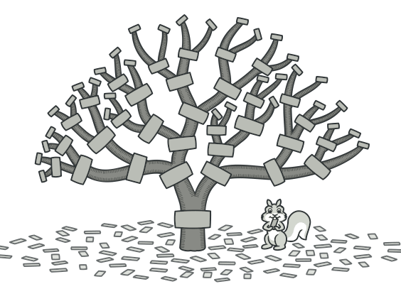
What is?
Composite is a structural design pattern that lets you compose objects into tree structures and then work with these structures as if they were individual objects.

